Slide 1


LAEDC Aerospace & Defense Industry Economic Blueprint Outline

Slide 2

2023
Welcome and Introductions

Slide 3
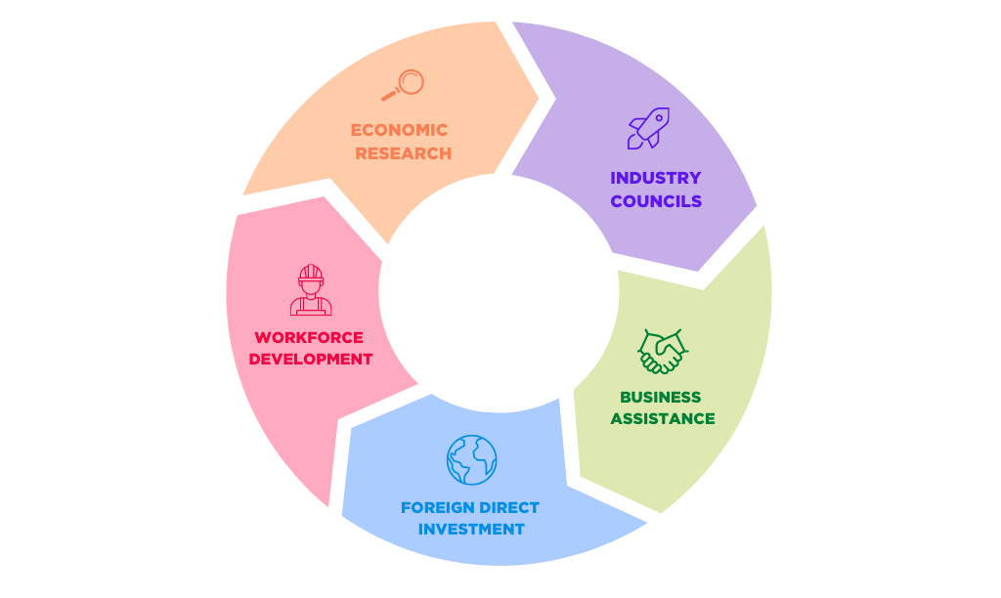
5 Pillar Strategy
For Economic Development
Economic Research – Objective economic research and analysis
Industry Councils – Advance connections programs and policies to increase business growth and hiring in the region
Business Assistance – Business attraction, retention, and expansion for the entire region
Foreign Direct Investment – Attracts investment into the region from foreign companies
Workforce Development – Aligns education with evolving industry trend
2023

Slide 4
2023
Blueprint Outline

Slide 5
Stage 1 - Inputs
Funding: LAEDC will work with local government entities, private investors, philanthropic partners, and leverage industry-specific grants to provide funding for Aerospace & Defense activities and businesses within the region.
Talent pipeline: LAEDC can help facilitate regional public private partnership collaboration with government, universities and community colleges to provide training for Aerospace & Defense talent, develop advanced research centers, and attract Aerospace & Defense talent to the region.
Research and information: The LAEDC's Institute of Applied Economics can provide research into Aerospace & Defense trends, new innovations and developments around Aerospace & Defense, and economic data on the Aerospace & Defense sector.
Community and industry engagement: LAEDC and other strategic partners can work with Aerospace & Defense businesses, community organizations, and other stakeholders to create strategic partnerships that support continued growth.
Technology: Industry driven development of new technology tools that will allow easier communication and collaboration within the Aerospace & Defense industry can be encouraged and supported.
2023

Slide 6
Stage 2 - Activities
Economic research: LAEDC Institute of Applied Economics in partnership with other research entities will conduct objective economic research and analysis on the Aerospace & Defense sector.
Industry councils: LAEDC can establish a regional Industry Council to identify and attract Aerospace & Defense businesses. The council can examine the needs of Aerospace & Defense businesses in LA County and work to create policies and programs that support their growth.
Business Assistance: LAEDC and other strategic partners will provide support for Aerospace & Defense businesses by offering assistance with business attraction, retention, and expansion.
Foreign direct investment: LAEDC through its subsidiary World Trade Center LA, can work with international investors to attract foreign investment in Aerospace & Defense companies located in LA County.
Workforce Development: LAEDC along with industry partners will work with community colleges and universities to align education and training with evolving industry trends in Aerospace & Defense.
2023

Slide 7
Stage 3 - Outputs
Quantitative and qualitative economic research and analysis reports on the Aerospace & Defense sector.
Identification and development of Aerospace & Defense clusters to attract new businesses and investments.
Business attraction, retention, and expansion support programs for Aerospace & Defense businesses.
Foreign direct investment in Aerospace & Defense companies located in LA County.
A highly skilled Aerospace & Defense workforce that is able to meet the needs of the Aerospace & Defense industry.
2023

Slide 8
Outcomes
Short-Term Outcomes:
Augmentation of stakeholder acumen regarding economic trends and regional issues pertinent to the Aerospace & Defense industry in LA County Intensified cross-industry cooperation within the Aerospace & Defense sector, generating novel synergies and strategic alliances Augmentation of local Aerospace & Defense business resource accessibility and insight comprehension Promotion of LA County as a prime destination for fresh business ventures and capital investment in the Aerospace & Defense sector Optimization of talent pipeline cultivation in our high-demand and rapidly growing Aerospace & Defense sectors
Medium-Term Outcomes:
Amplified understanding of economic possibilities in LA County's Aerospace & Defense industry Boosted growth and long-term stability of Aerospace & Defense businesses in the local economy Augmented capital investment in Aerospace & Defense sector within LA County Expanded workforce engagement and elevated economic mobility among underrepresented communities within the Aerospace & Defense industry
Long-Term Outcomes:
Comprehensive alteration across educational institutions, businesses, and regional infrastructures to support the growth of LA County's Aerospace & Defense industry Bolstering economic stability, growth, and equal opportunity in relation to the Aerospace & Defense industry, resulting in general prosperity for LA County Improvement in quality of life and community well-being, supported by Aerospace & Defense industry contributions to public safety Promotion of equitable access to affordable housing, other essential community services, and resources, incentivized by a thriving Aerospace & Defense industry cluster Significant increase in representation and involvement of historically overlooked communities in the LA economy, particularly within the Aerospace & Defense sector.
2023

Slide 9
External Factors
Economic conditions, industry trends, and regulations
Political climate and policies
Competition from other regions from an economical perspective
Social and demographic factors
Technological advancements and innovations
Environmental factors
Capital markets and the availability of funding and/or investment opportunities
2023

Slide 10
Impact Possibilities
Regional Aerospace & Defense Industry Council with engaged members and partnerships across all SPAs in the region
Increased # in Aerospace & Defense businesses receiving assistance and expanding across the region
Increased # in the amount of foreign direct investment into the Aerospace & Defense Industry within region
Increased alignment between education and industry trends leading to a more equitable talent pipeline.
2023

Slide 11
Accountability
Performance metrics and data collection to track progress and evaluate effectiveness
Feedback , data, and Information from stakeholders
Routine evaluation and improvement to refine processes and achieve better outcomes
2023

Slide 12
2023
Next Steps & Feedback & Discussion

Slide 13
Thank you!
www.laedc.org

