Slide 1
Allied Health Professions
Eve Adler

Slide 2

What are Allied Health Professions?
CCC Statewide Health Professionals Directory
http://www.lacccwc.com/cte-matrix/

Slide 3
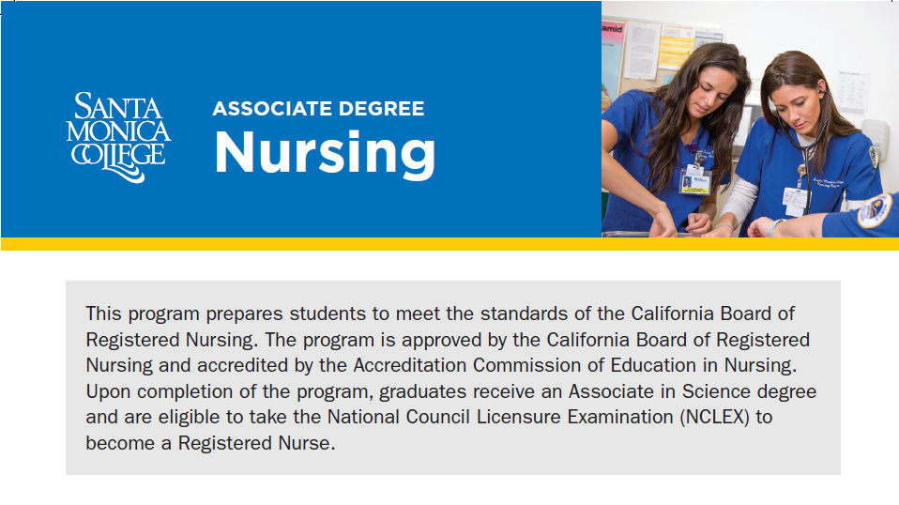

Slide 4
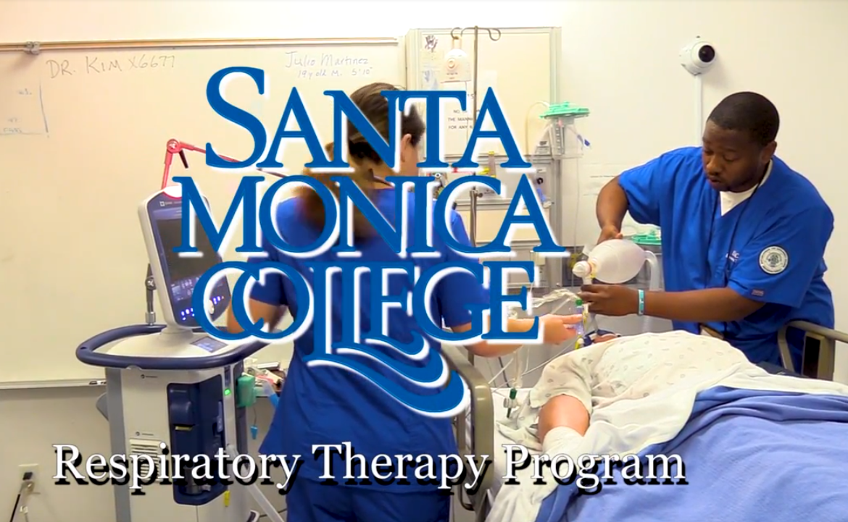

Slide 5

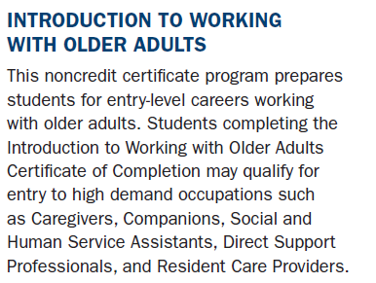

Slide 6
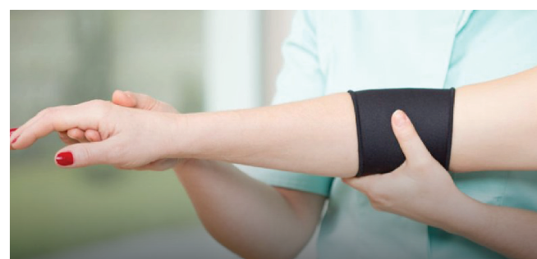

SANTA MONICA COLLEGE
REHABILITATION THERAPY AIDE NONCREDIT CERTIFICATE
FREE
C
OURSES
WHAT IS A REHAB AIDE?
Aides will maintain the treatment area, prepare and aid therapy sessions, aiding in the transport of immobile patients, and must be trained in proper methods of body
mechanics for patient assistance. Aides may also maintain and clean medical equipment and perform clerical tasks.
WHAT DO I NEED?
Aides are typically required by employers to hold a high school diploma. Aides can be trained by employers on the job, however most employers will select those who have already studied in the area of healthcare and demonstrate an interest in furthering their education in the health field.

Slide 7

Four courses with two goals (Certificate of Achievement)
1. Prepare students for entry level employment in the senior health care industry
2. Prepare students for entry into advance health care pathway programs

Slide 8
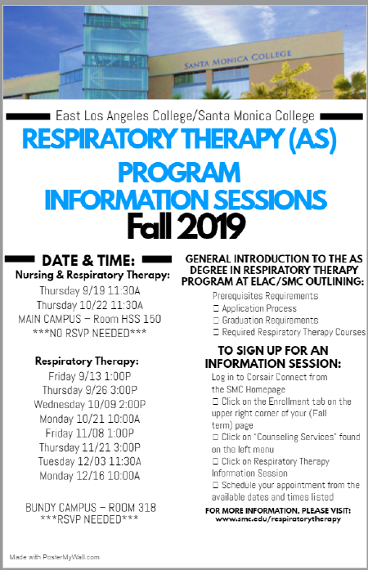

Slide 9
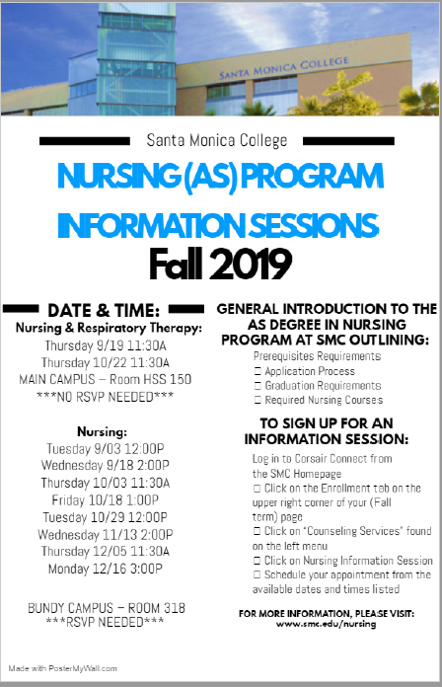

Slide 10
